Slide 1
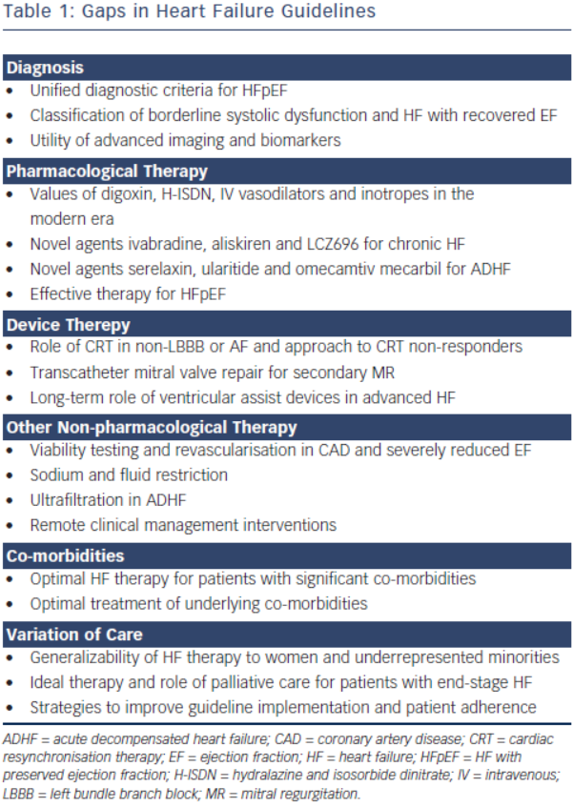
Tran B, Fonarow GC
Table 1: Gaps in Heart Failure Guidelines
Citation: Cardiac Failure Review 2015;1(1):50–5
https://doi.org/10.15420/cfr.2015.01.01.50

