Slide 1
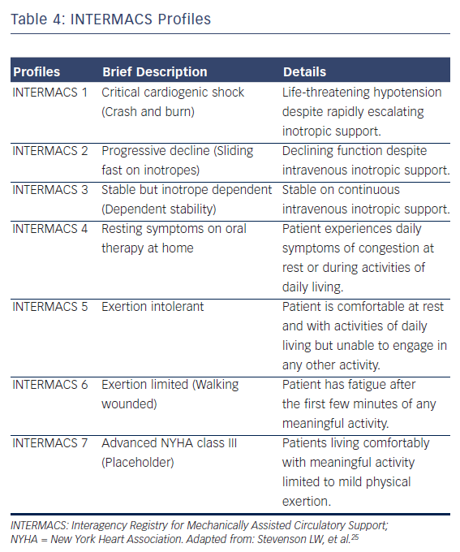
Birati EY, Jessup M
Table 4: INTERMACS Profiles
Citation: Cardiac Failure Review 2015;1(1):25–30
https://doi.org/10.15420/CFR.2015.01.01.25

