Slide 1
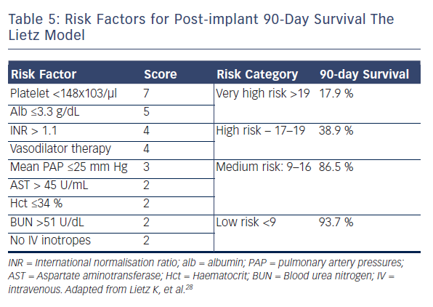
Birati EY, Jessup M
Table 5: Risk Factors for Post-implant 90-Day Survival The Lietz Model
Citation: Cardiac Failure Review 2015;1(1):25–30
https://doi.org/10.15420/CFR.2015.01.01.25

