Slide 1
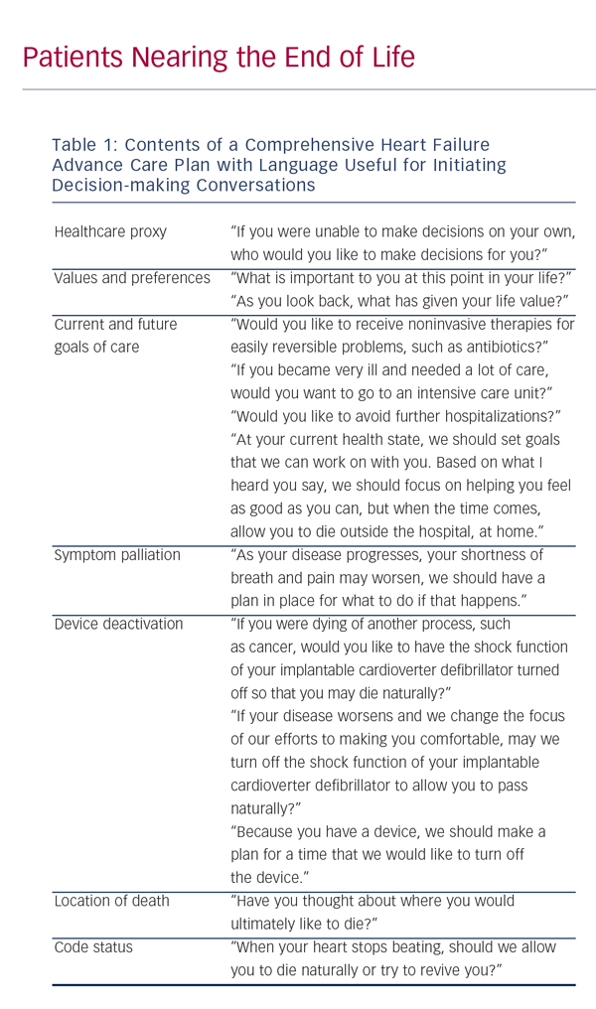
LeMond L, Goodlin SJ
Table 1: Contents of a Comprehensive Heart Failure Advance Care Plan with Language Useful for Initiating Decision-making Conversations
Citation: Cardiac Failure Review 2015;1(1):31–4
https://doi.org/10.15420/cfr.2015.01.01.31

