Slide 1
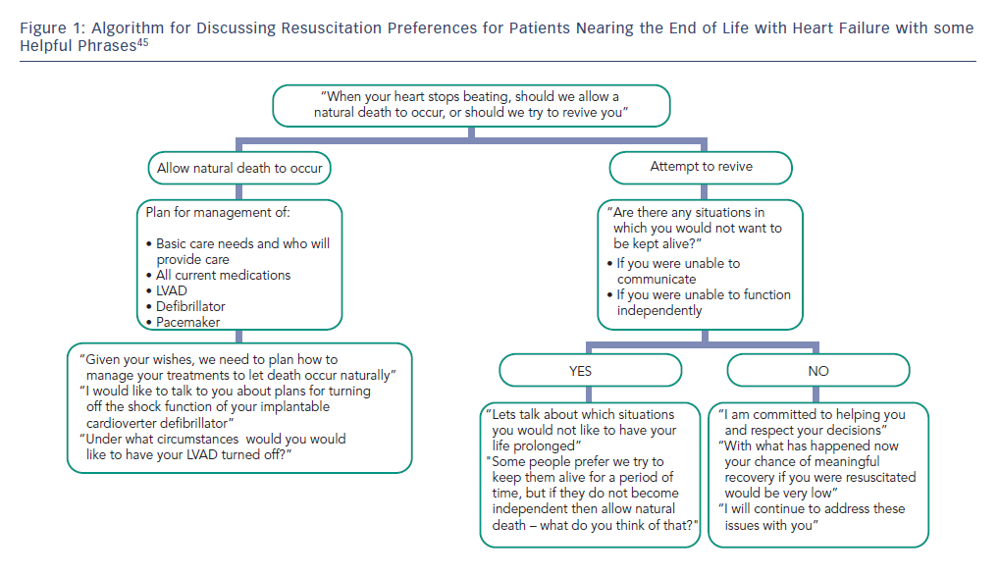
LeMond L, Goodlin SJ
Figure 1: Algorithm for Discussing Resuscitation Preferences for Patients Nearing the End of Life with Heart Failure with some Helpful Phrases
Citation: Cardiac Failure Review 2015;1(1):31–4
https://doi.org/10.15420/cfr.2015.01.01.31

