Slide 1
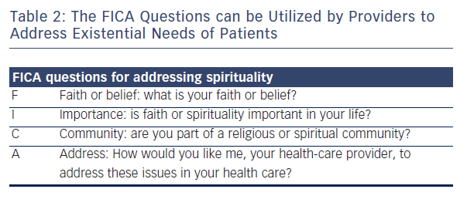
LeMond L, Goodlin SJ
Table 2: The FICA Questions can be Utilized by Providers to Address Existential Needs of Patients
Citation: Cardiac Failure Review 2015;1(1):31–4
https://doi.org/10.15420/cfr.2015.01.01.31

