Slide 1
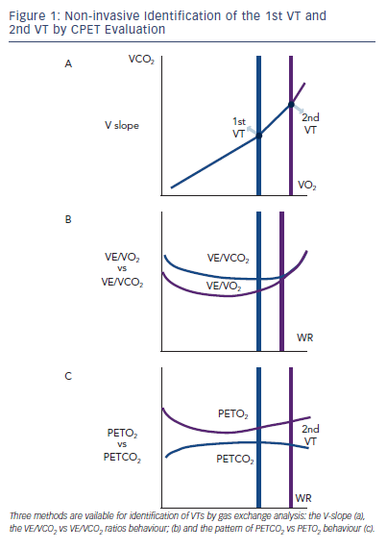
Guazzi M
Figure 1: Non-invasive Identification of the 1st VT and 2nd VT by CPET Evaluation
Citation: Cardiac Failure Review 2015;1(1):46–9
https://doi.org/10.15420/cfr.2015.01.01.46

