Slide 1

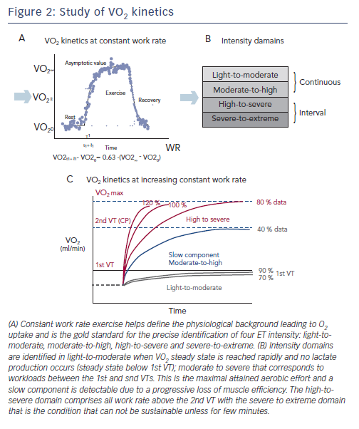
Guazzi M
Figure 2: Study of VO2 kinetics
Citation: Cardiac Failure Review 2015;1(1):46–9
https://doi.org/10.15420/cfr.2015.01.01.46

