Slide 1
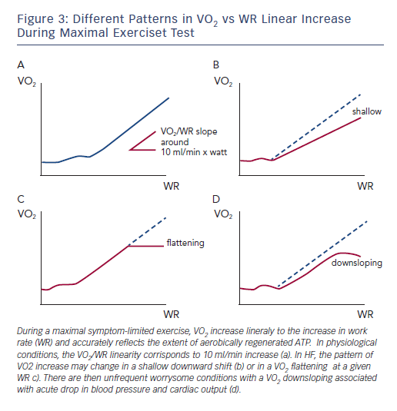
Guazzi M
Figure 3: Different Patterns in VO2 vs WR Linear Increase During Maximal Exerciset Test
Citation: Cardiac Failure Review 2015;1(1):46–9
https://doi.org/10.15420/cfr.2015.01.01.46

