Slide 1
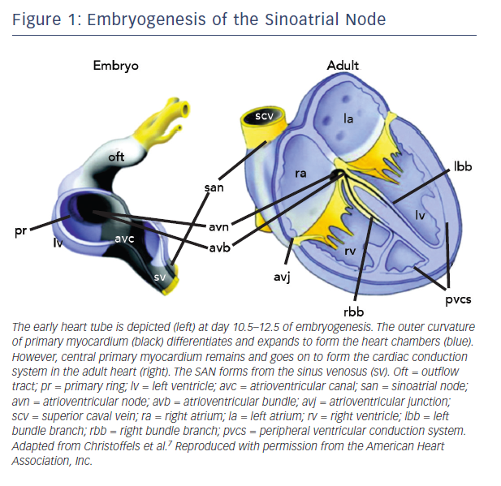
Choudhury M, Boyett MR, Morris GM
Figure 1: Embryogenesis of the Sinoatrial Node
Citation: Arrhythmia & Electrophysiology Review 2015;4(1):28–34
https://doi.org/10.15420/aer.2015.4.1.28

