Slide 1
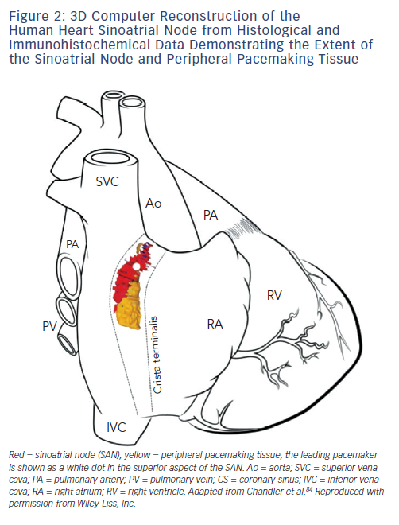
Choudhury M, Boyett MR, Morris GM
Figure 2: 3D Computer Reconstruction of the Human Heart Sinoatrial Node from Histological and Immunohistochemical Data Demonstrating the Extent of the Sinoatrial Node and Peripheral Pacemaking Tissue
Citation: Arrhythmia & Electrophysiology Review 2015;4(1):28–34
https://doi.org/10.15420/aer.2015.4.1.28

