Slide 1
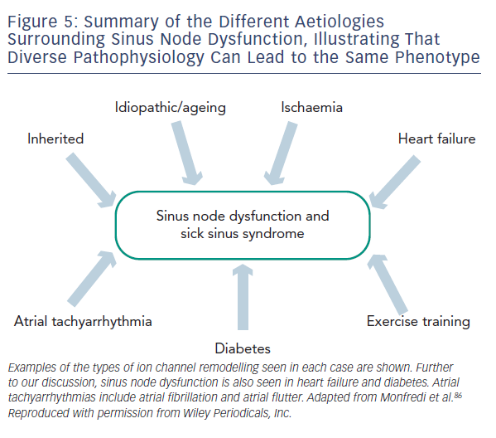
Choudhury M, Boyett MR, Morris GM
Figure 5: Summary of the Different Aetiologies Surrounding Sinus Node Dysfunction, Illustrating That Diverse Pathophysiology Can Lead to the Same Phenotype
Citation: Arrhythmia & Electrophysiology Review 2015;4(1):28–34
https://doi.org/10.15420/aer.2015.4.1.28

