Slide 1
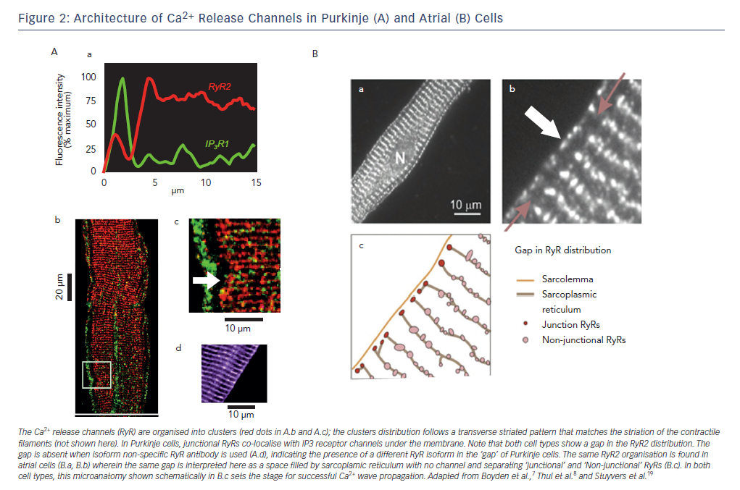
Boyden PA, Dun W, Stuyvers BD
Figure 2: Architecture of Ca2+ Release Channels in Purkinje (A) and Atrial (B) Cells
Citation: Arrhythmia & Electrophysiology Review 2015;4(1):35–9
https://doi.org/10.15420/aer.2015.4.1.35

