Slide 1
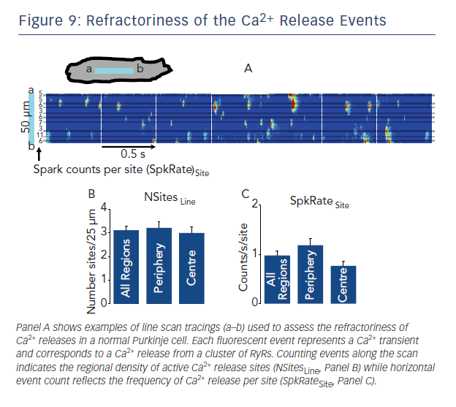
Boyden PA, Dun W, Stuyvers BD
Figure 9: Refractoriness of the Ca2+ Release Events
Citation: Arrhythmia & Electrophysiology Review 2015;4(1):35–9
https://doi.org/10.15420/aer.2015.4.1.35

