Slide 1
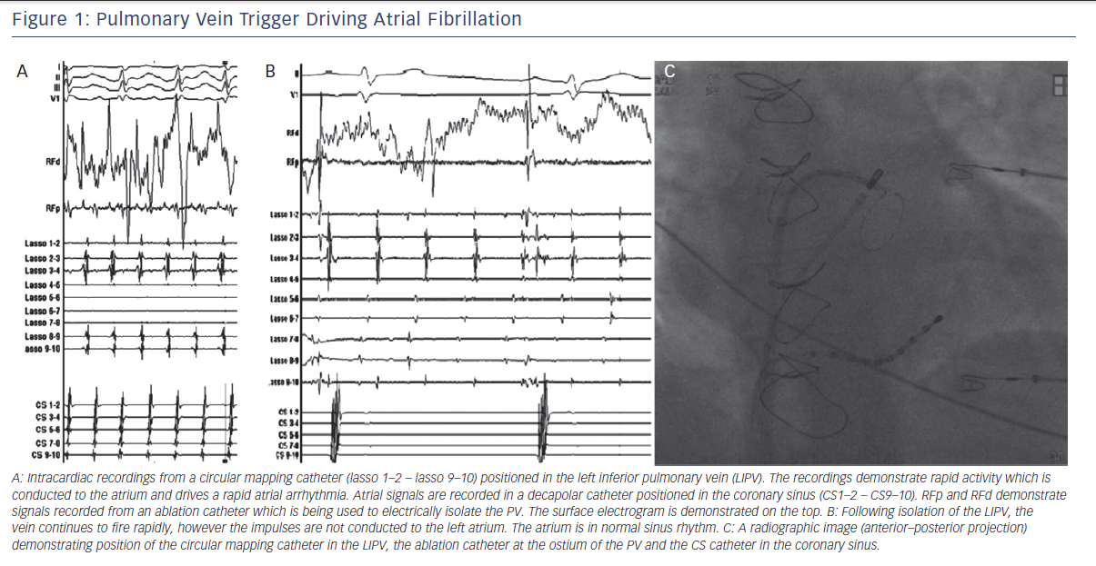
Mahida S, Sacher F, Derval N, Berte B, Yamashita S, Hooks D, Denis A, Amraoui S, Hocini M, Haissaguerre M, Jaïs P
Pulmonary Vein Trigger Driving AF
Citation: Arrhythmia & Electrophysiology Review 2015;4(1):40–3
https://doi.org/10.15420/aer.2015.4.1.40

