Slide 1

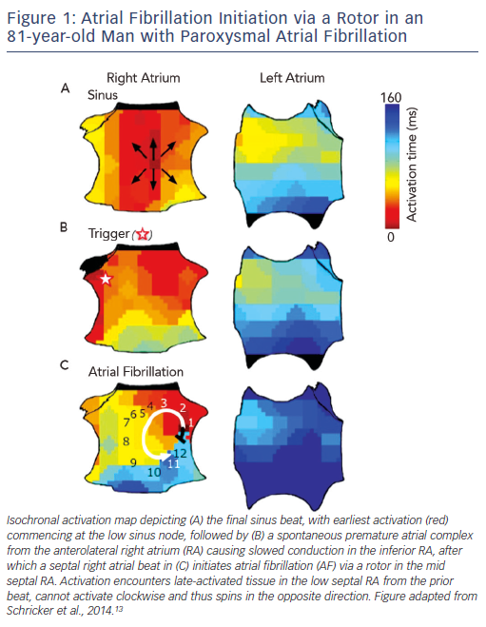
Schricker AA, Zaman JA, Narayan SM
AF Initiation via a Rotor in an 81 old Man with Paroxysmal AF
Citation: Arrhythmia & Electrophysiology Review 2015;4(1):47–52
https://doi.org/10.15420/aer.2015.4.1.47

