Slide 1
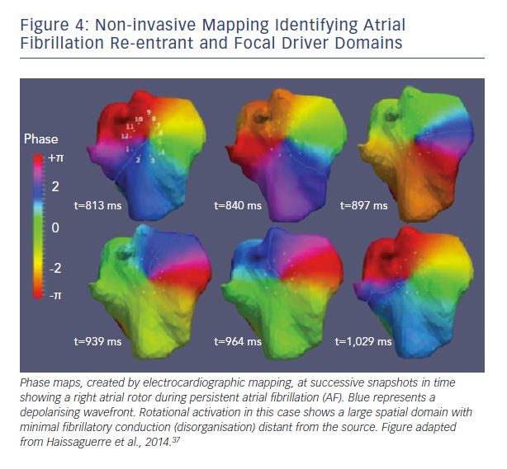
Schricker AA, Zaman JA, Narayan SM
Non-invasive Mapping Indntifying AF Re-entrant &amp; Focal Driver Domains
Citation: Arrhythmia & Electrophysiology Review 2015;4(1):47–52
https://doi.org/10.15420/aer.2015.4.1.47

