Slide 1
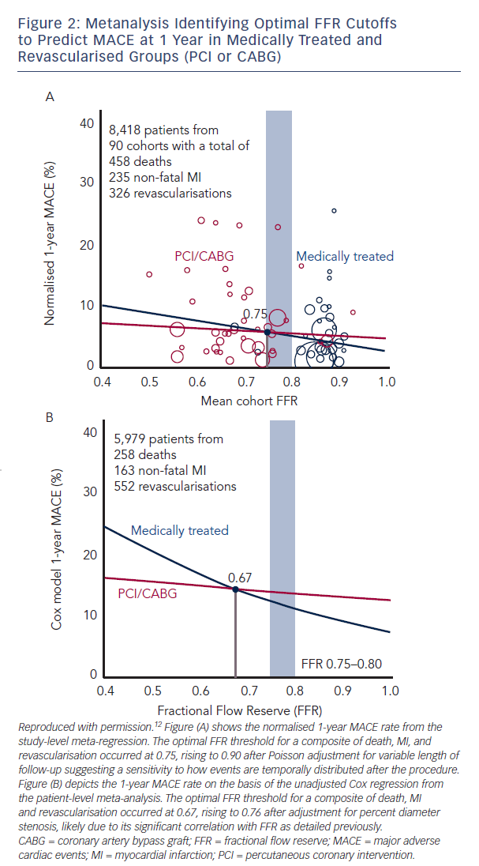
Hennigan B, Robertson K, Berry C, Oldroyd KG
Figure 2: Metanalysis Identifying Optimal FFR Cutoffs to Predict MACE at 1 Year in Medically Treated and Revascularised Groups (PCI or CABG)
Citation: Interventional Cardiology Review 2015;10(2):72–8
https://doi.org/10.15420/icr.2015.10.2.72

