Slide 1
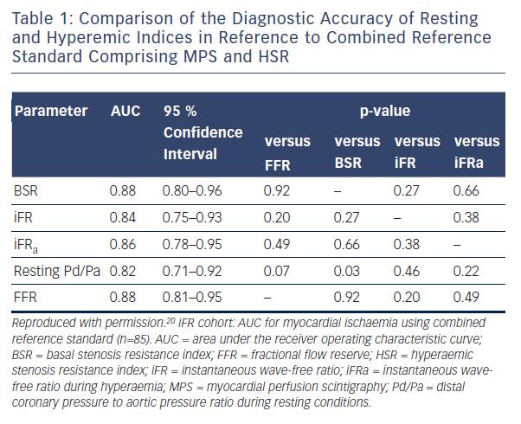
Hennigan B, Robertson K, Berry C, Oldroyd KG
Table 1: Comparison of the Diagnostic Accuracy of Resting and Hyperemic Indices in Reference to Combined Reference Standard Comprising MPS and HSR
Citation: Interventional Cardiology Review 2015;10(2):72–8
https://doi.org/10.15420/icr.2015.10.2.72

