Slide 1
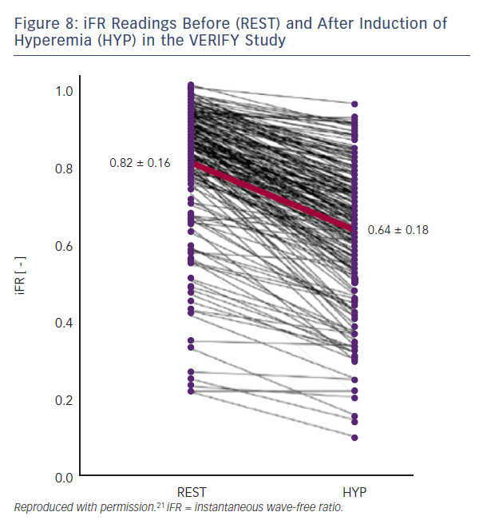
Hennigan B, Robertson K, Berry C, Oldroyd KG
Figure 8: iFR Readings Before (REST) and After Induction of Hyperemia (HYP) in the VERIFY Study
Citation: Interventional Cardiology Review 2015;10(2):72–8
https://doi.org/10.15420/icr.2015.10.2.72

