Slide 1
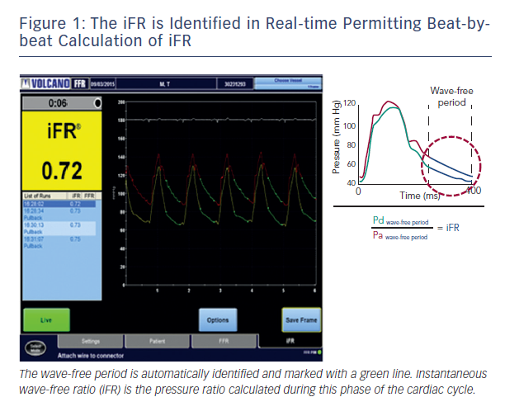
Sen S, Davies JE
Figure 1: The iFR is Identified in Real-time Permitting Beat-bybeat Calculation of iFR
Citation: Interventional Cardiology Review 2015;10(2):79–84
https://doi.org/10.15420/icr.2015.10.2.79

