Slide 1
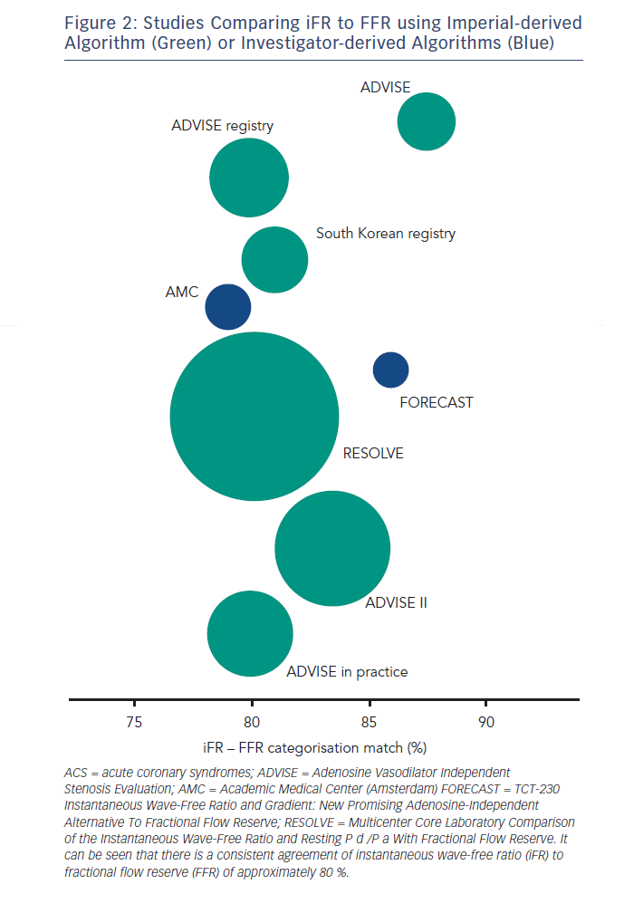
Sen S, Davies JE
Figure 2: Studies Comparing iFR to FFR using Imperial-derived Algorithm (Green) or Investigator-derived Algorithms (Blue)
Citation: Interventional Cardiology Review 2015;10(2):79–84
https://doi.org/10.15420/icr.2015.10.2.79

