Slide 1
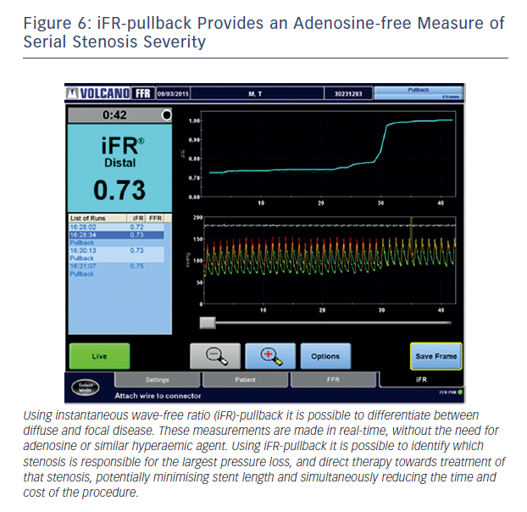
Sen S, Davies JE
Figure 6: iFR-pullback Provides an Adenosine-free Measure of Serial Stenosis Severity
Citation: Interventional Cardiology Review 2015;10(2):79–84
https://doi.org/10.15420/icr.2015.10.2.79

