Slide 1
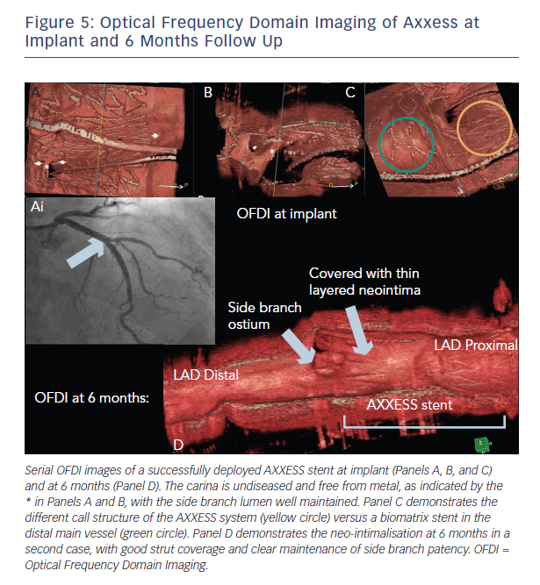
Rawlins J, Din J, Talwar S, O’Kane P
Figure 5: Optical Frequency Domain Imaging of Axxess at Implant and 6 Months Follow Up
Citation: Interventional Cardiology Review 2015;10(2):85–9
https://doi.org/10.15420/icr.2015.10.2.85

