Slide 1
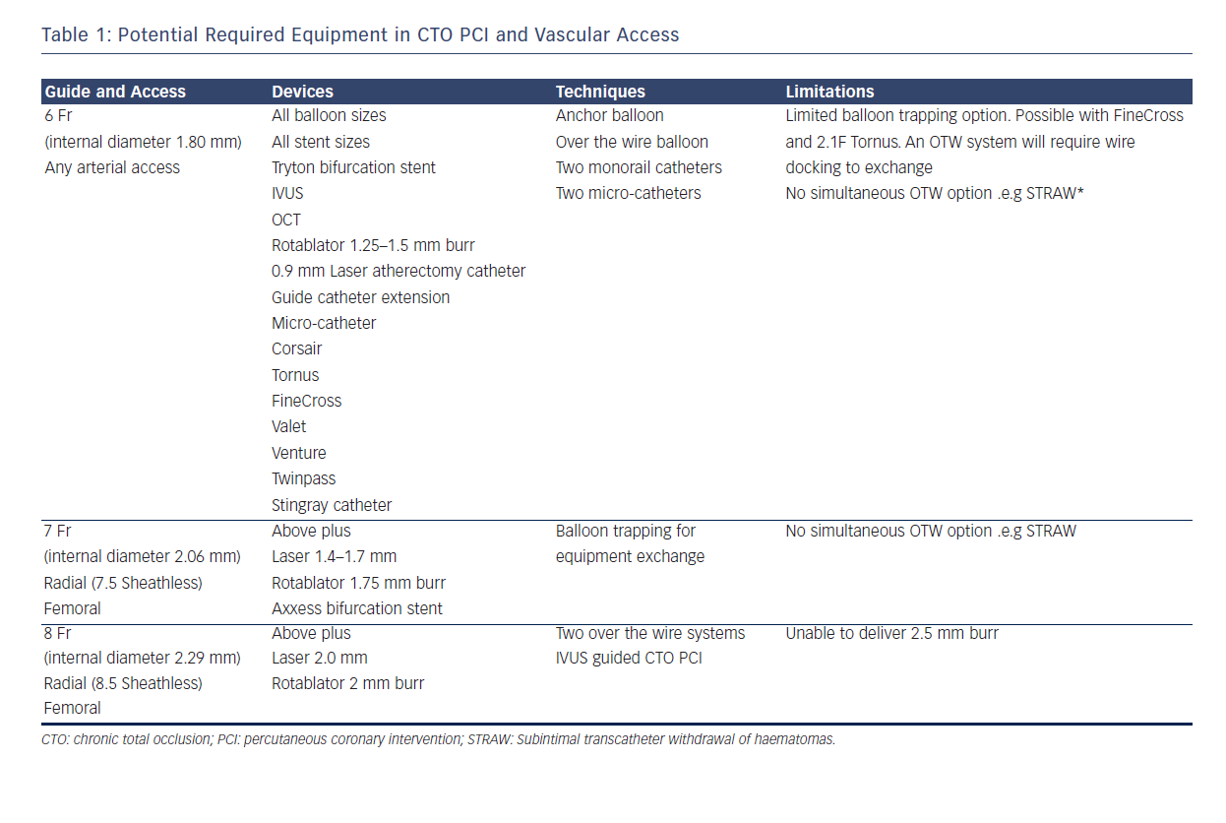
Smith D, Hailan A, Chase A
INTERVENTIONAL CARDIOLOGY REVIEW 91 Fluoroscopy-guided Femoral Punctures Fluoroscopic landmarks have been widely used in every day interventional practice and are described in Figure 2. The clinical benefits of this modality have not been reported in randomised trials. However, use of fluoroscopic-guided femoral arterial access has been demonstrated to reduce bleeding-related complications in female patients.13 In addition, prospective registry data have demonstrated fluoroscopy use prior to art
Citation: Interventional Cardiology Review 2015;10(2):90–3
https://doi.org/10.15420/icr.2015.10.2.90

