Slide 1
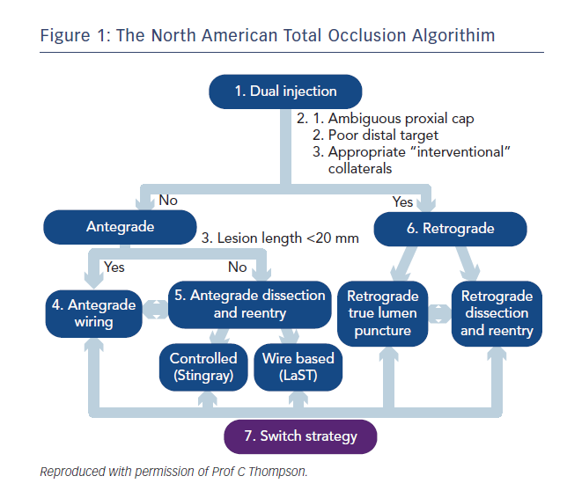
Smith D, Hailan A, Chase A
Figure 1: The North American Total Occlusion Algorithim
Citation: Interventional Cardiology Review 2015;10(2):90–3
https://doi.org/10.15420/icr.2015.10.2.90

