Slide 1
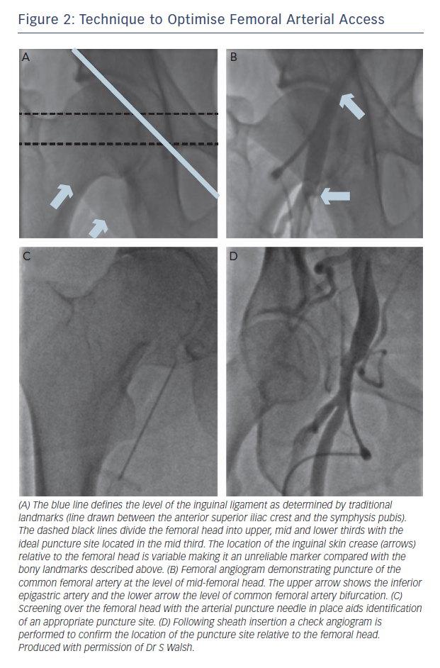
Smith D, Hailan A, Chase A
Figure 2: Technique to Optimise Femoral Arterial Access
Citation: Interventional Cardiology Review 2015;10(2):90–3
https://doi.org/10.15420/icr.2015.10.2.90

