Slide 1
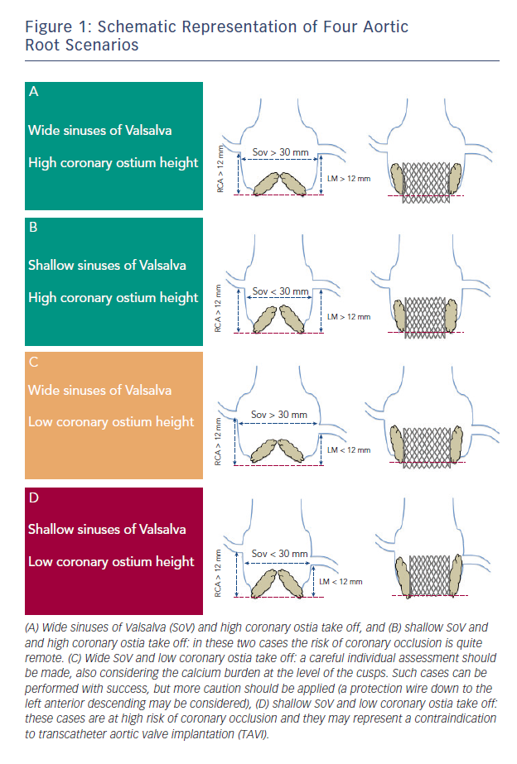
Barbanti M
Figure 1: Schematic Representation of Four Aortic Root Scenarios
Citation: Interventional Cardiology Review 2015;10(2):94–7
https://doi.org/10.15420/icr.2015.10.2.94

