Slide 1
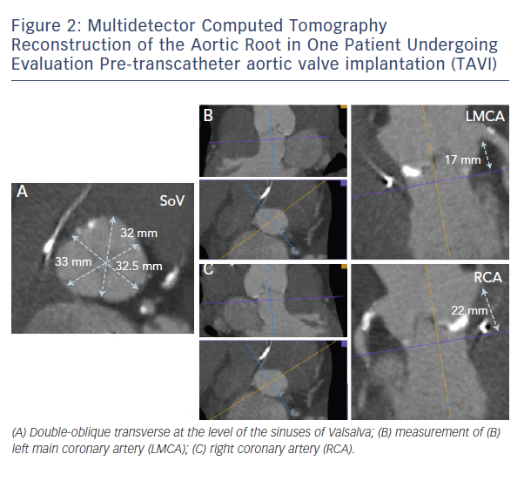
Barbanti M
Figure 2: Multidetector Computed Tomography Reconstruction of the Aortic Root in One Patient Undergoing Evaluation Pre-transcatheter aortic valve implantation (TAVI)
Citation: Interventional Cardiology Review 2015;10(2):94–7
https://doi.org/10.15420/icr.2015.10.2.94

