Slide 1
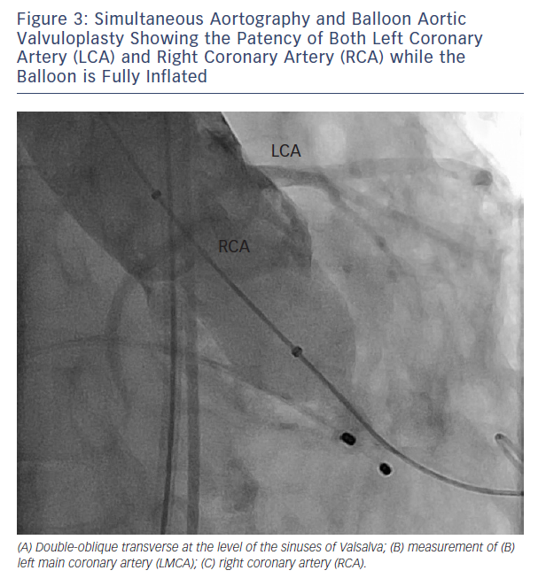
Barbanti M
Figure 3: Simultaneous Aortography and Balloon Aortic Valvuloplasty Showing the Patency of Both Left Coronary Artery (LCA) and Right Coronary Artery (RCA) while the Balloon is Fully Inflated
Citation: Interventional Cardiology Review 2015;10(2):94–7
https://doi.org/10.15420/icr.2015.10.2.94

