Slide 1
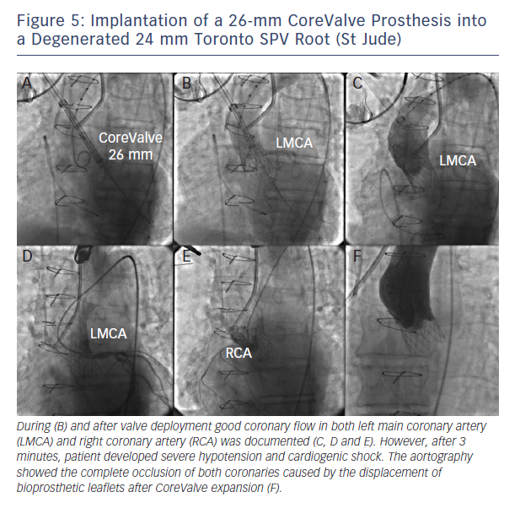
Barbanti M
Figure 5: Implantation of a 26-mm CoreValve Prosthesis into a Degenerated 24 mm Toronto SPV Root (St Jude)
Citation: Interventional Cardiology Review 2015;10(2):94–7
https://doi.org/10.15420/icr.2015.10.2.94

