Slide 1
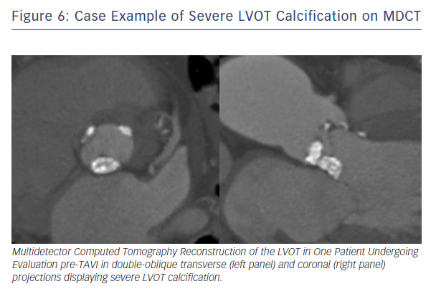
Barbanti M
Figure 6: Case Example of Severe LVOT Calcification on MDCT
Citation: Interventional Cardiology Review 2015;10(2):94–7
https://doi.org/10.15420/icr.2015.10.2.94

