Slide 1
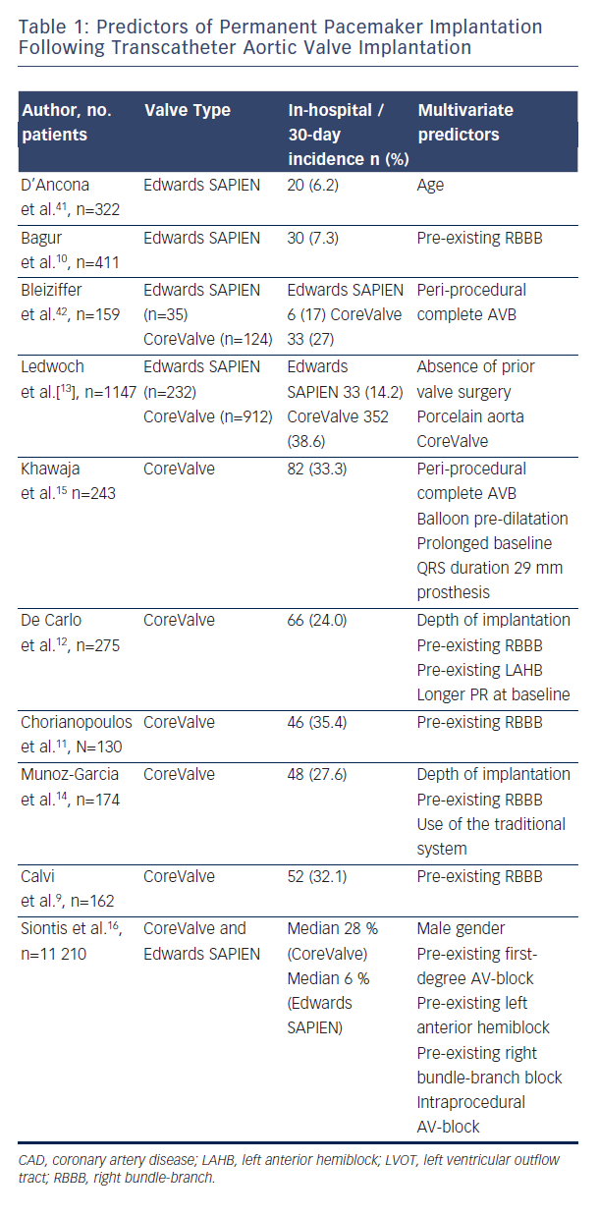
Weber M, Sinning JM, Hammerstingl C, Werner N, Grube E, Nickenig G
Table 1: Predictors of Permanent Pacemaker Implantation Following Transcatheter Aortic Valve Implantation
Citation: Interventional Cardiology Review 2015;10(2):98–102
https://doi.org/10.15420/icr.2015.10.2.98

