Slide 1
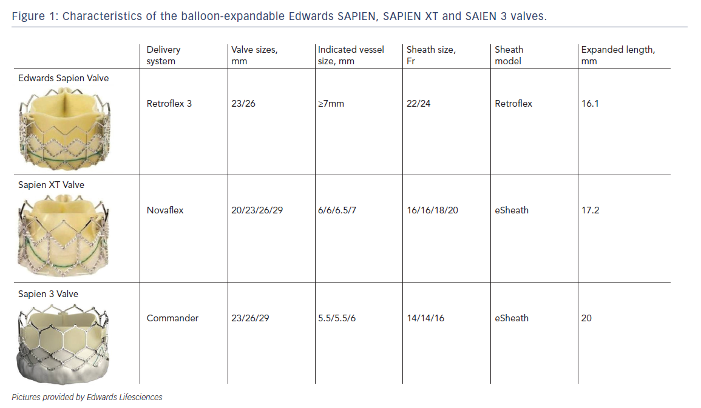
Jose J, Richardt G, Abdel-Wahab M
Figure 1: Characteristics of the balloon-expandable Edwards SAPIEN, SAPIEN XT and SAIEN 3 valves.
Citation: Interventional Cardiology Review 2015;10(2):103-8
https://doi.org/10.15420/icr.2015.10.2.103

