Slide 1

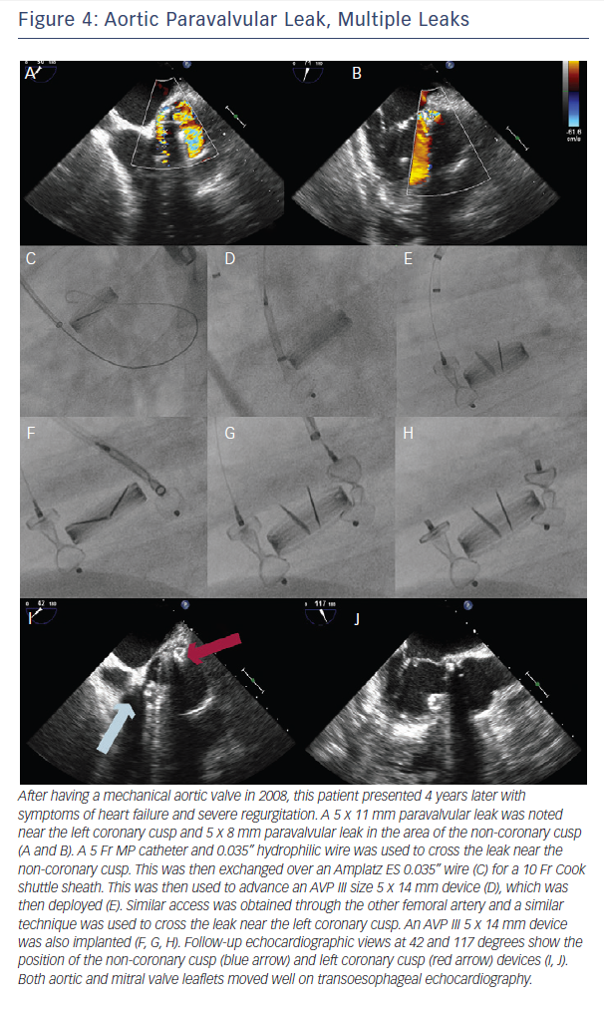
Gafoor S, Franke J, Bertog S, Lam S, Vaskelyte L, Hofmann I, Sievert H, Matic P
Figure 4: Aortic Paravalvular Leak, Multiple Leaks
Citation: Interventional Cardiology Review 2015;10(2):112–7
https://doi.org/10.15420/icr.2015.10.2.112

