Slide 1
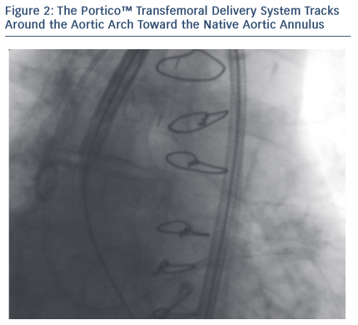
Agnifili M, Brambilla N, Testa L, Bollati M, Bedogni F
Figure 2: The Portico™ Transfemoral Delivery System Tracks Around the Aortic Arch Toward the Native Aortic Annulus
Citation: RadcliffeCardiology.com, June 2015

