Slide 1
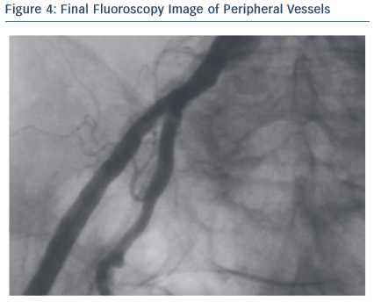
Agnifili M, Brambilla N, Testa L, Bollati M, Bedogni F
Figure 4: Final Fluoroscopy Image of Peripheral Vessels
Citation: RadcliffeCardiology.com, June 2015

