Slide 1
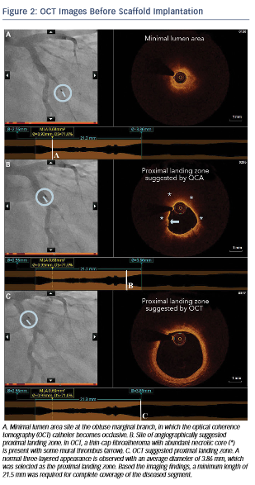
Karanasos A, Sijde JNvd, Ligthart JM, Witberg K, Regar E
OCT Images Before Scaffold Implantation
Citation: RadcliffeCardiology.com, July 2015

