Slide 1
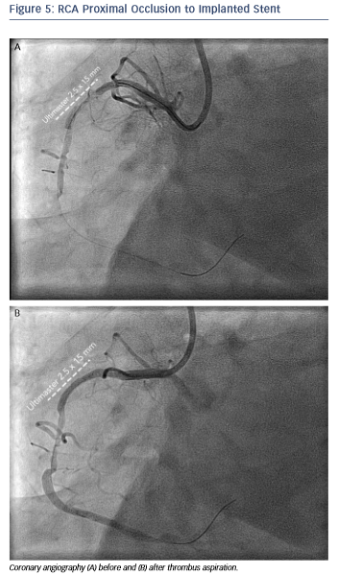
Karanasos A, Sijde JNvd, Ligthart JM, Witberg K, Regar E
RCA Proximal Occlusion to Implanted Stent
Citation: RadcliffeCardiology.com, July 2015

