Slide 1
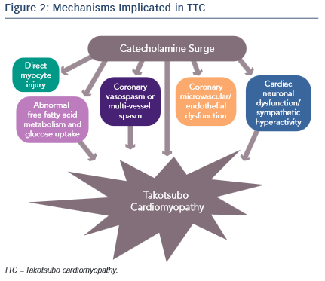
Sachdev E, Bairey Merz CN, Mehta PK
Mechanisms Implicated in TTC
Citation: European Cardiology Review 2015;10(1):25–30
https://doi.org/10.15420/ecr.2015.10.01.25

