Slide 1
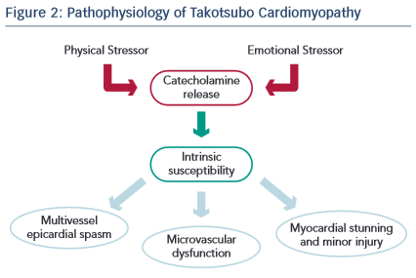
Prasad A
Pathophysiology of Takotsubo Cardiomyopathy
Citation: European Cardiology Review 2015;10(1):6–8
https://doi.org/10.15420/ecr.2015.10.01.6

