Slide 1
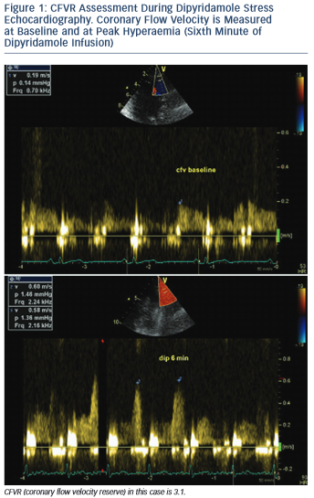
Simova I
CFVR Assessment During Dipyridamole Stress Echocardiography. Coronary Flow Velocity is Measured at Baseline and at Peak Hyperaemia (Sixth Minute of Dipyridamole Infusion)
Citation: European Cardiology Review 2015;10(1):12–8
https://doi.org/10.15420/ecr.2015.10.01.12

