Slide 1
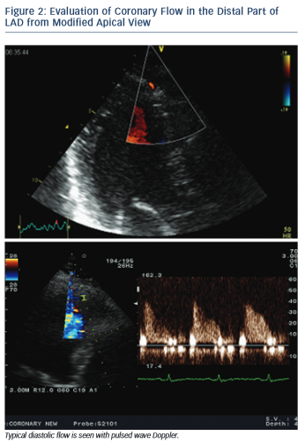
Simova I
Evaluation of Coronary Flow in the Distal Part of LAD from Modified Apical View
Citation: European Cardiology Review 2015;10(1):12–8
https://doi.org/10.15420/ecr.2015.10.01.12

