Slide 1
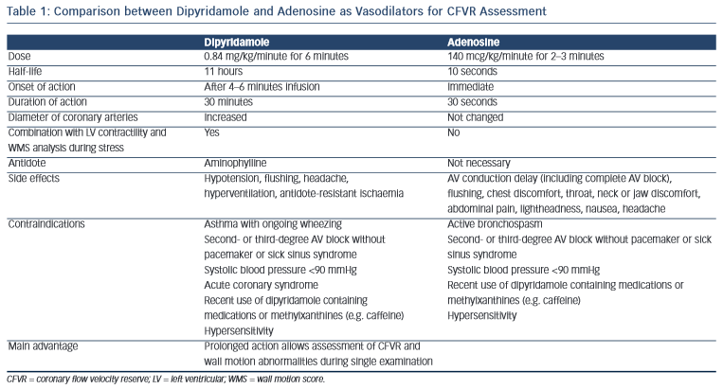
Simova I
Comparison between Dipyridamole and Adenosine as Vasodilators for CFVR Assessment
Citation: European Cardiology Review 2015;10(1):12–8
https://doi.org/10.15420/ecr.2015.10.01.12

