Slide 1
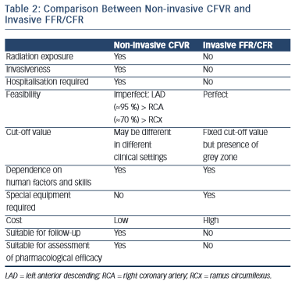
Simova I
Comparison Between Non-invasive CFVR and Invasive FFR/CFR
Citation: European Cardiology Review 2015;10(1):12–8
https://doi.org/10.15420/ecr.2015.10.01.12

