Slide 1
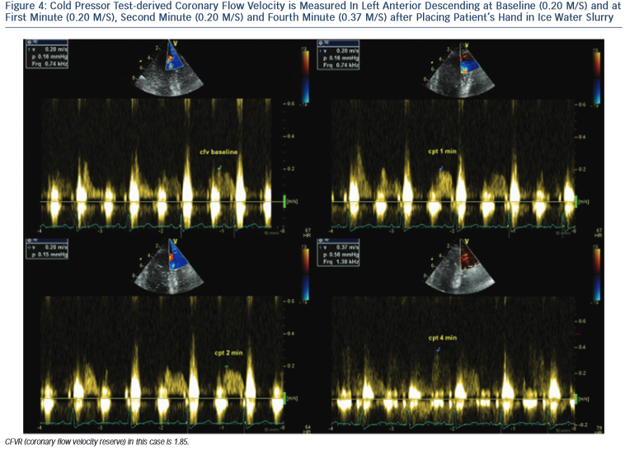
Simova I
Cold Pressor Test-derived Coronary Flow Velocity is Measured In Left Anterior Descending at Baseline (0.20 M/S) and at First Minute (0.20 M/S), Second Minute (0.20 M/S) and Fourth Minute (0.37 M/S) after Placing Patient’s Hand in Ice Water Slurry
Citation: European Cardiology Review 2015;10(1):12–8
https://doi.org/10.15420/ecr.2015.10.01.12

