Slide 1
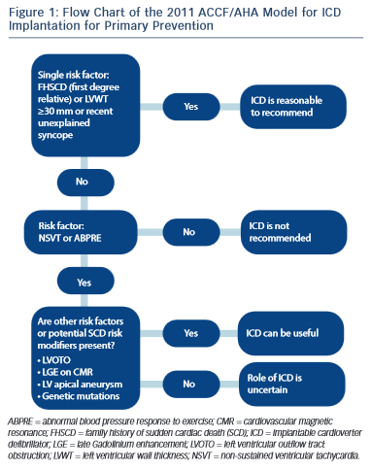
Steriotis AK, Sharma S
Flow Chart of the 2011 ACCFAHA Model
Citation: European Cardiology Review 2015;10(1):31–6
https://doi.org/10.15420/ecr.2015.10.01.31

