Slide 1
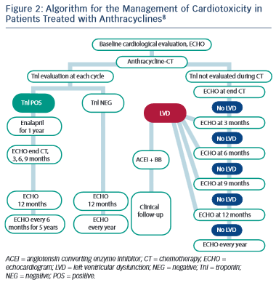
Piper SE, McDonagh TA
Algorithm for the Management of Cardiotoxicity in Patients Treated with Anthracyclines8
Citation: European Cardiology Review 2015;10(1):19–24
https://doi.org/10.15420/ecr.2015.10.01.19

