Slide 1
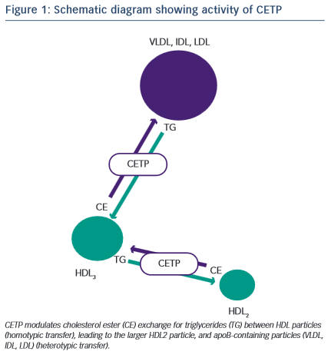
Huggins C, Charolidi N, Cockerill GW
Schematic diagram showing activity of CETP
Citation: European Cardiology Review 2015;10(1):64–7
https://doi.org/10.15420/ecr.2015.10.01.64

