Slide 1
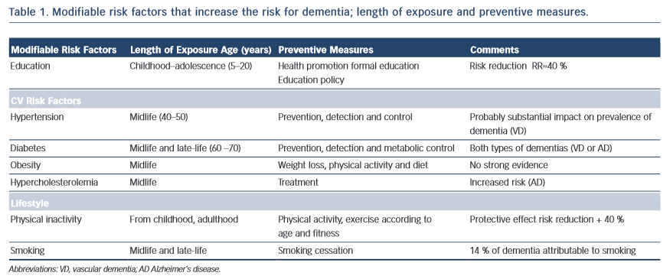
Vicario A, Cerezo GH
Modifiable risk factors that increase the risk for dementia
Citation: European Cardiology Review 2015;10(1):60–3
https://doi.org/10.15420/ecr.2015.10.01.60

